Slide 1


Noida Institute of Engineering and Technology, Greater Noida
LOGIC SIMPLIFICATION
Unit: 1
COA
AMIT YADAV
Assistant Professor
Department of Electronics and Communication Engineering
B Tech: 3rd Sem.

Slide 2
Number System
Prerequisite:
Basics of decimal number system.

Slide 3
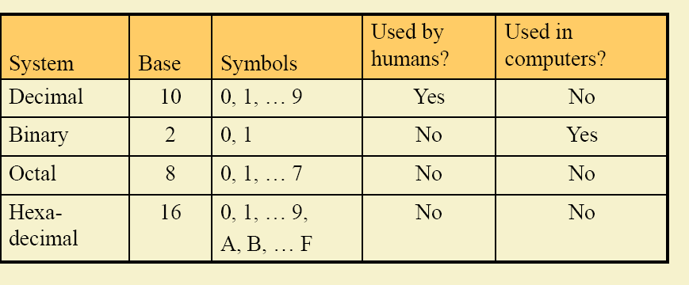
INTRODUCTION TO NUMBER SYSTEMS
In digital electronics, the number system is used for representing the information.
The number system has different bases and the most common of them are the decimal, binary, octal, and hexadecimal.
The base or radix of the number system is the total number of the digit used in the number system.
Suppose if the number system representing the digit from 0 – 9 then the base of the system is the 10.

Slide 4
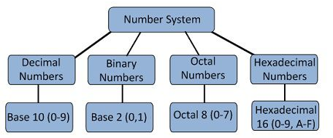
NUMBER SYSTEMS
Types of Number Systems
Some of the important types of number system are:
Decimal Number System
Binary Number System
Octal Number System
Hexadecimal Number System

Slide 5
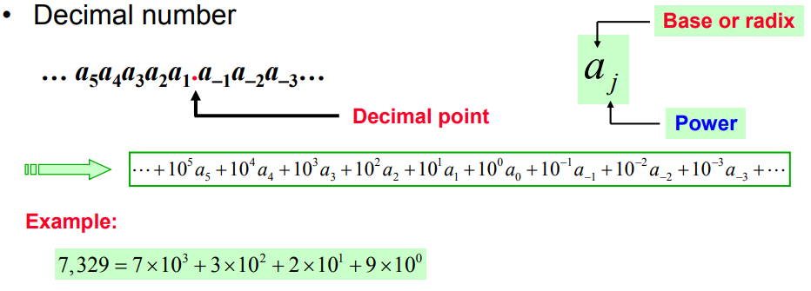
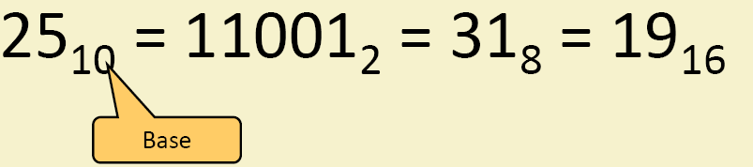
DECIMAL NUMBER SYSTEMS
The number system is having digit 0, 1, 2, 3, 4, 5, 6, 7, 8, 9;
this number system is known as a decimal number system because total ten digits are involved.
The base of the decimal number system is 10.

Slide 6
BINARY NUMBER SYSTEMS
The modern computers do not process decimal number; they work with another number system known as a binary number system which uses only two digits 0 and1.
The base of binary number system is 2 because it has only two digit 0 and 1.
The digital electronic equipment's are works on the binary number system and hence the decimal number system is converted into binary system.
The table is shown below the decimal, binary, octal, and hexadecimal numbers from 0 to 15 and their equivalent binary number.

Slide 7
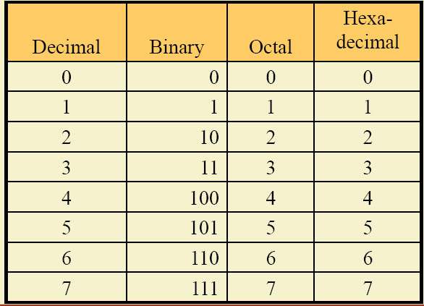
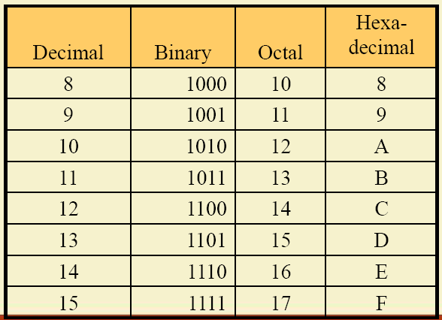
BINARY NUMBER SYSTEMS

Slide 8
OCTAL NUMBERS
The base of a number system is equal to the number of digits used, i.e., for decimal number system the base is ten while for the binary system the base is two. The octal system has the base of eight as it uses eight digits 0, 1, 2, 3, 4, 5, 6, 7.
All these digits from 0 to 7 have the same physical meaning as by decimal symbols, the next digit in the octal number is represented by 10, 11, 12, which are equivalent to decimal digits 8, 9, 10 respectively.
In this way, the octal number 20 will represent the decimal digit and subsequently, 21, 22, 23.. Octal numbers will represent the decimal number digit 17, 18, 19… etc. and so on.

Slide 9
HEXADECIMAL NUMBERS
These numbers are used extensively in microprocessor. The hexadecimal number system has a base of 16, and hence it consists of the following sixteen number of digits.
0, 1, 2, 3, 4, 5, 6, 7, 8, 9, A, B, C, D, E, F.
The size of the hexadecimal is much shorter than the binary number which makes them easy to write and remember.
Let 0000 to 000F representing hexadecimal numbers from zero to fifteen, then 0010, 0011, 0012, …etc. Will represent sixteen, seventeen, eighteen… etc. till 001F which represent thirty open and so on.

Slide 10
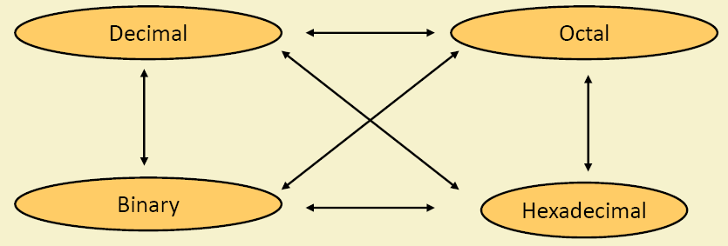
CODE CONVERSION
Conversion among base:

Slide 11
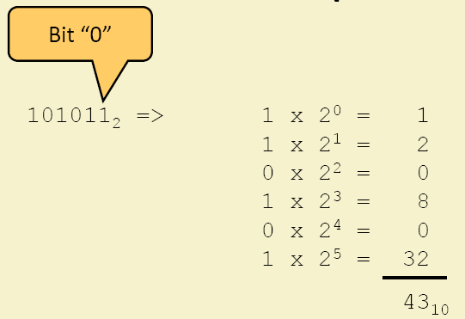
BINARY TO DECIMAL CONVERSION:
Multiply each bit by 2^n,where n is “weight” of the bits
The weight is the position of the bit starting form zero from right.
Add the result
Example:

Slide 12
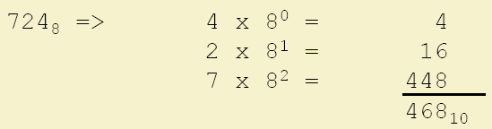
OCTAL TO DECIMAL
multiplying each digit by 8^n bits where n the weight of the digits.
the weight is the position of the digit starting from 0 on the right
add the result
example:

Slide 13
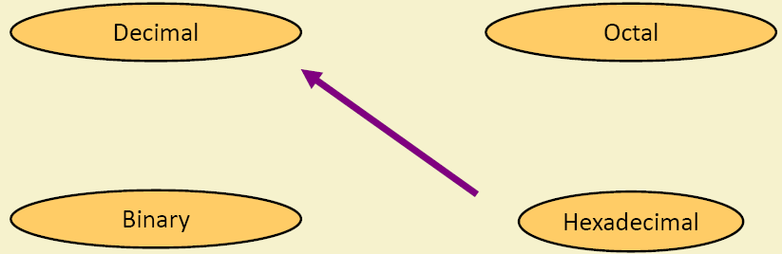
HEXADECIMAL TO DECIMAL

Slide 14
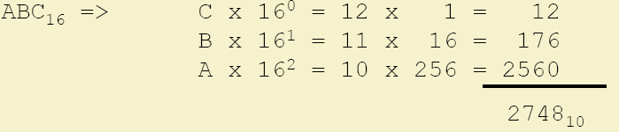
HEXADECIMAL TO DECIMAL CONVERSION
Multiplying each digit by 16^n bits where n the weight of the digits.
The weight is the position of the digit starting from 0 on the right
Add the result
Example:

Slide 15
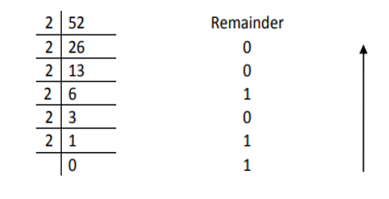
DECIMAL TO BINARY CONVERSION
Example : convert (52)10 to binary.
Sol:
(52)₁₀ = (110100)₂

Slide 16
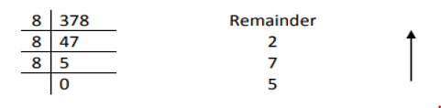
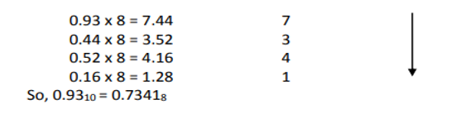
DECIMAL TO BINARY CONVERSION
Example : Convert (378.93)10 to binary Sol:
Ans: (378.93)₁₀ = (572.7341)₈

Slide 17

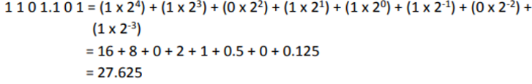
BINARY TO DECIMAL CONVERSION
Example : Convert (10101)2 to decimal.
(10101)₂ = (21)₁₀
Example : Convert (11011.101)2 to decimal.
(11011.101)₂ = (27.625)₁₀

Slide 18
Boolean algebra & Logic Gates
Prerequisite:
Knowledge of basic logic gates.

Slide 19
Boolean algebra & Logic Gates
Boolean Algebra is used to analyze and simplify the digital (logic) circuits. It uses only the binary numbers i.e. 0 and 1. It is also called as Binary Algebra or logical Algebra. Boolean algebra was invented by George Boole in 1854
Binary logic consists of binary variables and a set of logical operations. The variables are designated by letters of the alphabet, such as A, B, C, x, y, z, etc, with each variable having two and only two distinct possible values: 1 and 0, There are three basic logical operations: AND, OR, and NOT.

Slide 20
Boolean algebra & Logic Gates
Following are the important rules used in Boolean algebra.
Variable used can have only two values. Binary 1 for HIGH and Binary 0 for LOW.
Complement of a variable is represented by an overbar (-).
ORing of the variables is represented by a plus (+) sign between them. For example ORing of A, B, C is represented as A + B + C.
Logical ANDing of the two or more variable is represented by writing a dot between them such as A.B.C. Sometime the dot may be omitted like ABC.

Slide 21
Boolean algebra & Logic Gates
There are six types of Boolean Laws.
1) Commutative law:
Any binary operation which satisfies the following expression is referred to as commutative operation.
Commutative law states that changing the sequence of the variables does not have any effect on the output of a logic circuit.
2) Associative law:
This law states that the order in which the logic operations are performed is irrelevant as their effect is the same.

Slide 22


Boolean algebra & Logic Gates
Distributive law:
Distributive law states the following condition.
AND law
These laws use the AND operation. Therefore they are called as AND laws.
OR law
These laws use the OR operation. Therefore they are called as OR laws

Slide 23

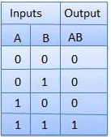
Boolean algebra & Logic Gates
AND Gate
A circuit which performs an AND operation is shown in figure. It has n input (n >= 2) and one output.
Logic diagram
Truth Table

Slide 24

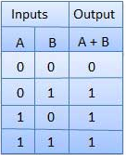
Boolean algebra & Logic Gates
OR Gate
A circuit which performs an OR operation is shown in figure. It has n input (n >= 2) and one output.
Logic diagram
Truth Table

Slide 25

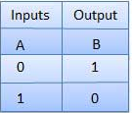
Boolean algebra & Logic Gates
NOT Gate
NOT gate is also known as Inverter. It has one input A and one output Y.
Symbol
Truth Table

Slide 26

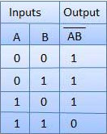
Boolean algebra & Logic Gates
NAND Gate
A NOT-AND operation is known as NAND operation. It has n input (n >= 2) and one output.
Logic diagram
Truth Table

Slide 27

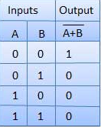
Boolean algebra & Logic Gates
NOR Gate
A NOT-OR operation is known as NOR operation. It has n input (n >= 2) and one output.
Logic diagram
Truth Table

Slide 28

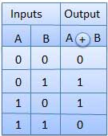
Boolean algebra & Logic Gates
XOR Gate:
XOR or Ex-OR gate is a special type of gate. It can be used in the half adder, full adder and subtractor. The exclusive-OR gate is abbreviated as EX-OR gate or sometime as X-OR gate. It has n input (n >= 2) and one output.
Logic diagram
Truth Table

Slide 29

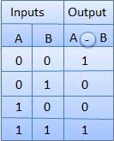
Boolean algebra & Logic Gates
XNOR Gate
XNOR gate is a special type of gate. It can be used in the half adder, full adder and subtractor. The exclusive-NOR gate is abbreviated as EX-NOR gate or sometime as X-NOR gate. It has n input (n >= 2) and one output.
Logic diagram
Truth Table

Slide 30
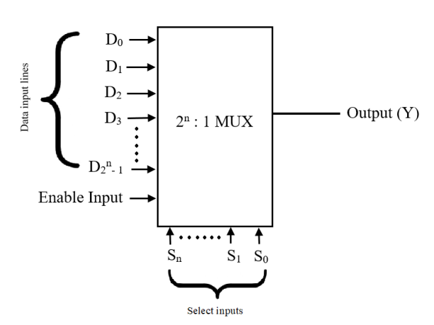
Multiplexer
Depending on the digital code applied at the selected inputs, one out of n data sources is selected and transmitted to the single output Y. E is called the strobe or enable input which is useful for the cascading. It is generally an active low terminal, that means it will perform the required operation when it is low.

Slide 31
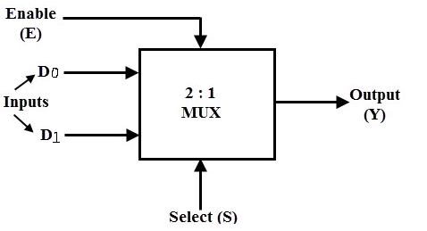
Multiplexer
2 *1 MUX:
A 2-to-1 multiplexer consists of two inputs D0 and D1, one select input S and one output Y. Depends on the select signal, the output is connected to either of the inputs.
If the select line is low, then the output will be switched to D0 input, whereas if select line is high, then the output will be switched to D1 input.

Slide 32
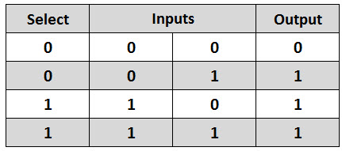
Multiplexer
From the truth table the Boolean expression of the output is given as:
Truth Table :
It consists of two AND gates, one NOT gate and one OR gate. When the select line, S=0, the output of the upper AND gate is zero, but the lower AND gate is D0.

Slide 33
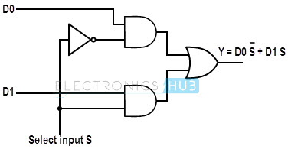
Multiplexer
Thus, the output generated by the OR gate is equal to D0. Similarly, when S=1, the output of the lower AND gate is zero, but the output of upper AND gate is D1. Therefore, the output of the OR gate is D1. Thus, the above given Boolean expression is satisfied by this circuit.

Slide 34
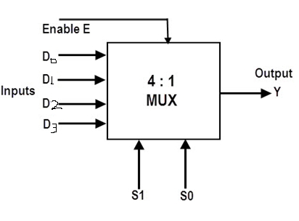
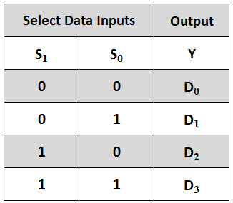
Multiplexer
4*1 MUX :A 4-to-1 multiplexer consists four data input lines as D0 to D3, two select lines as S0 and S1 and a single output line Y. The select lines S1 and S2 select one of the four input lines to connect the output line. The particular input combination on select lines selects one of input (D0 through D3). output.

Slide 35
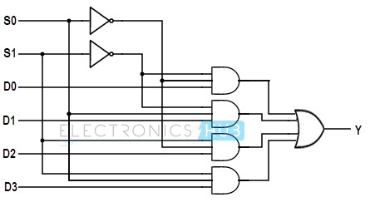
Multiplexer
Boolean expression of this multiplexer is given as:

Slide 36
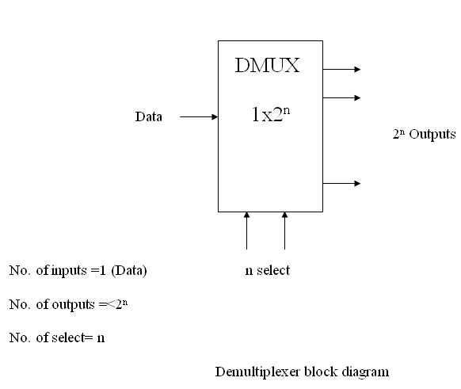
Demultiplexer
A demultiplexer (or demux) is a device that takes a single input line and routes it to one of several digital output lines. A demultiplexer of 2^{n} outputs has n select lines, which are used to select which output line to send the input. A demultiplexer is also called a data distributor.

Slide 37
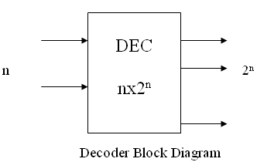

Decoder
A decoder is a combinational circuit that converts binary information from n input lines to a maximum of 2^{n} unique output lines.

Slide 38
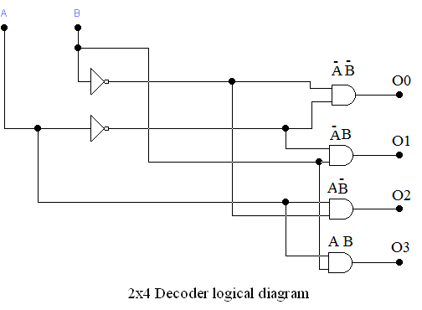
Decoder

Slide 39
Thank You

